Slide 1
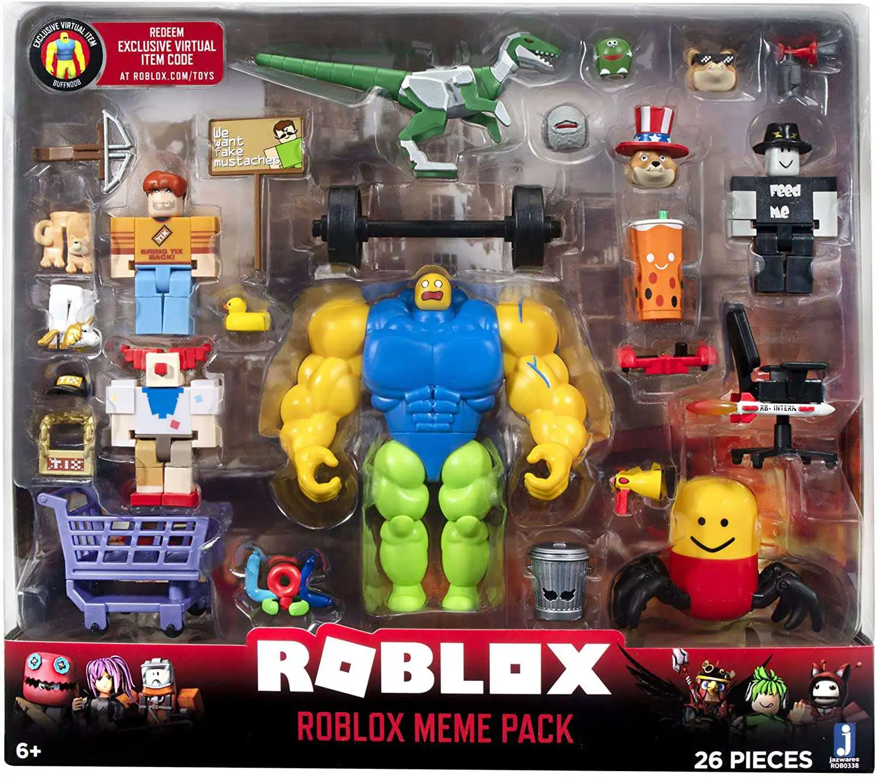
Toys

Slide 2
Very fun toy
It is fun because it has lots of pieces

